Slide 1




Data-Limited Fisheries Toolkit
Evaluating management strategies for data-limited fish species
Custom output control MPs
Lecture 5b, May 2017
Tom Carruthers & Adrian Hordyk .
Nicolas Gutierrez

Slide 2
Agenda
Input control MP design
Effort controls
Spatial controls
Size limits

Slide 3
Design of input control MPs (class ‘Input’)
Very similar to output control MPs but rather than returning a vector of TACs that is reps long, input control MPs return a vector of input regulations:
AnInputMP = function(x, Data, ...) {
< code for calculating Allocate, Effort, Spatial and Vuln based on simulation x of Data >
c(Allocate, Effort, Spatial, Vuln)
}
The fraction of effort in newly closed areas that is reallocated to open areas.
A number: e.g. Allocate = 0.5

Slide 4
Design of input control MPs (class ‘Input’)
Very similar to output control MPs but rather than returning a vector of TACs that is reps long, input control MPs return a vector of input regulations:
AnInputMP = function(x, Data, ...) {
< code for calculating Allocate, Effort, Spatial and Vuln based on simulation x of Data >
c(Allocate, Effort, Spatial, Vuln)
}
TAE: expressed as the fraction of current effort (effort in last historical year)
A number: e.g. Effort = 0.9

Slide 5
Design of input control MPs (class ‘Input’)
Very similar to output control MPs but rather than returning a vector of TACs that is reps long, input control MPs return a vector of input regulations:
AnInputMP = function(x, Data, ...) {
< code for calculating Allocate, Effort, Spatial and Vuln based on simulation x of Data >
c(Allocate, Effort, Spatial, Vuln)
}
Degree of spatial closure (fraction of current effort) in the 2 areas of DLMtool.
A vector 2-long: e.g. Spatial = c(0.5, 1)

Slide 6
Design of input control MPs (class ‘Input’)
Very similar to output control MPs but rather than returning a vector of TACs that is reps long, input control MPs return a vector of input regulations:
AnInputMP = function(x, Data, ...) {
< code for calculating Allocate, Effort, Spatial and Vuln based on simulation x of Data >
c(Allocate, Effort, Spatial, Vuln)
}
Three parameters of the enforced size vulnerability, in order of length at 5% vulnerability, length at full selection
A vector 2-long: e.g. Vuln = c(128, 139)

Slide 7
An effort control MP using mean length data
MLTarg = function(x, Data, …){
currentYR = length(Data@Year)
Effort=Data@ML[x, currentYR] / Data@L50[x]
c(1, Effort, 1, 1, NA, NA)
}
No spatial closure
Size limit is not specified
No spatial reallocation
Effort is current Effort multiplied by the ratio of mean length in the catch (ML) to length at 50% maturity (L50)

Slide 8
A fixed spatial control MP
Close1 = function(x, Data, …){
c(1, 1, 0, 1, NA, NA)
}
Size limit is not specified
No spatial reallocation
Area 1 is shut
Effort is current effort

Slide 9
A fixed size limit
SL95 = function(x, Data, …){
c(1, 1, 1, 1, 90, 100)
}
Size limit is ~95cm, with allowance for +/- 5cm.
In this case length at 5% vulnerability is 90cm, length at full vulnerability is 100cm
No spatial reallocation
No spatial closure
Effort is current effort

Slide 10
Remember the 3 more things?
We have to assign the right class to our new MPs:
class(MLTarg) = class(Close1) = class(SL95) = “Input”
They have to be visible to DLMtool:
environment(MLTarg) = environment(MLTarg) =
environment(SL95) = “DLMtool”
And they should be compatible with parallel processing:
sfExport(list=c(“MLTarg”, ”Close1”, ”SL95”))

Slide 11
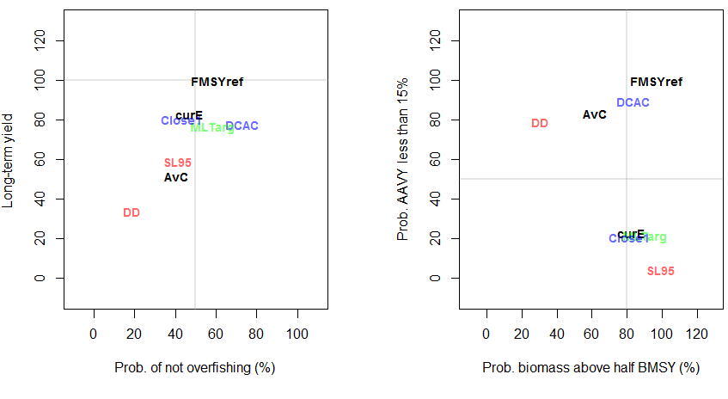
How did they do for an Albacore OM?

